Slide 1
Adversarial Text-to-Image
Generating an image from a text description using generative adversarial network

Slide 2
Problem definition and its motivation
Generate photo-realistic images matching a text description
This can be used for image editing
It also can be used by artists to visualize an initial form of their works
It can be used for image retrieval by trying to generate images and search for images that closely match the generated.

Slide 3
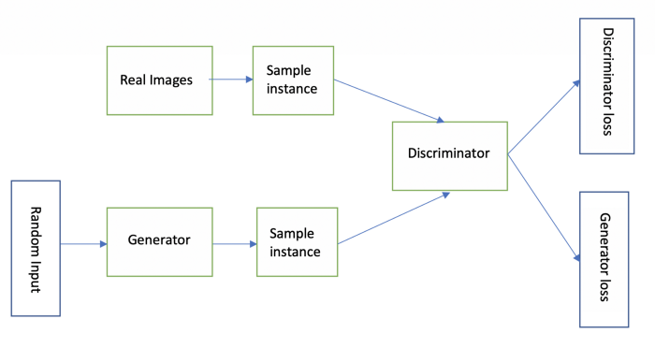
Brief Introduction to generative adversarial Network
It consists of two deep learning models the generator and the discriminator
Both models train against each other in an adversarial way.
Mathematically, it is known as a “Zero-sum game”.

Slide 4

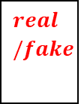

Brief Introduction to generative adversarial Network
Y
It is an extension of the architecture which is also known as conditional GAN
The discriminator should know if the image is real or not and if it matches the condition or not.
Real Caption
Real Image
Z
$$real/fake$$
$$𝓁_{adv}$$
G
D
Noise
Generator
Discriminator
Y
$$𝓁_{c}$$
Real Caption

Slide 5
Matching-Aware Discriminator GAN-CLS
Image Statues | Caption Statues | Correct Prediction
Fake Image | Mismatching Caption | Fake
Real Image | Mismatching Caption | Fake
Fake Image | Matching Caption | Fake
Real Image | Matching Caption | Real
The discriminator has to refuse images if it does not match the text description

Slide 6
Generator Interpolate (GAN-INT)
Generate additional caption for the generator by interpolating two points.
Subsequently, the discriminator does not have a “real” image corresponding to the interpolated captions
Discriminator should inspect if the generated image matches the text input.
If the discriminator did well in this task, the generator learns to fill the gaps in the data manifolds.

Slide 7
First trial Mix both approaches (GAN-INT-CLS)
GAN-INT improves the generator.
GAN-CLS improves the discriminator.
GAN-INT-CLS improves the adversarial model.

Slide 8
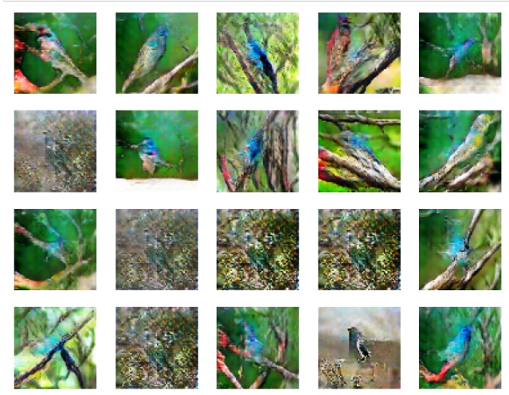
Qualitative Results for GAN-INT-CLS
Text-input: “ This bird is blue”
This shows some blue image that looks like a bird.
It is a trivial prompt. What if it is more complex

Slide 9
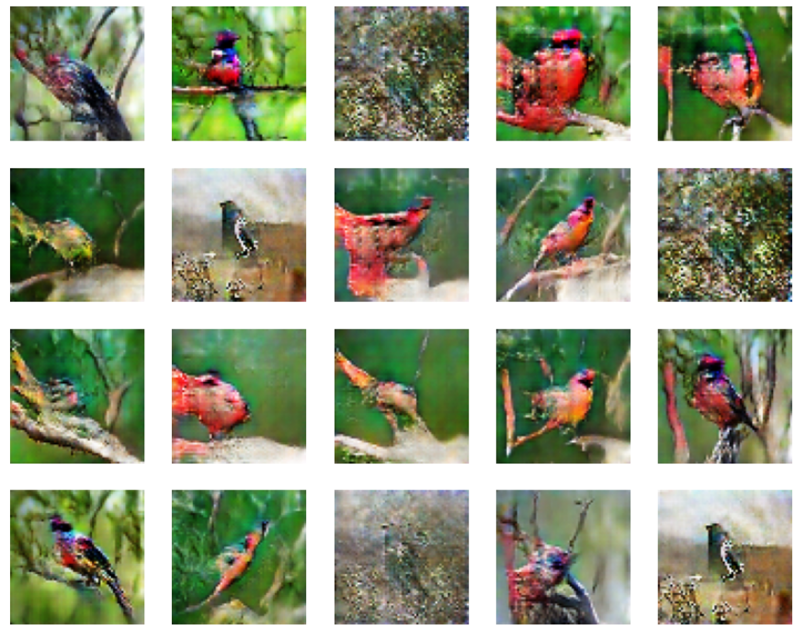
Complex input:
Input text: “This bird has red head and blue body.”
It can be observed it missed the detail of “blue body” the image is overly red.

Slide 10
Quantitative results
After training for 1000 epochs, it scored Fréchet Inception Distance (FID) of 421

Slide 11
Second attempt: Instance Selection
Instance selection is a technique to choose a subset of a dataset that represents the training data to reduce its size or remove noisy points.
Instance selection is used for classification problems
Instance selection goes through two steps.
Image embedding projection F(x) using Inspection model
Each image is scored by scoring function H(F(x))
The selected instance is the top N%

Slide 12
Second attempt: Instance Selection
On our trial we choose the best 70%
It was built on top of GAN-INT-CLS
We observed:
The training time is improved by 37%
There is a room for a larger model
It scored an FID of 435, compared to 421 with only 630 epochs
Qualitatively it was not good

Slide 13
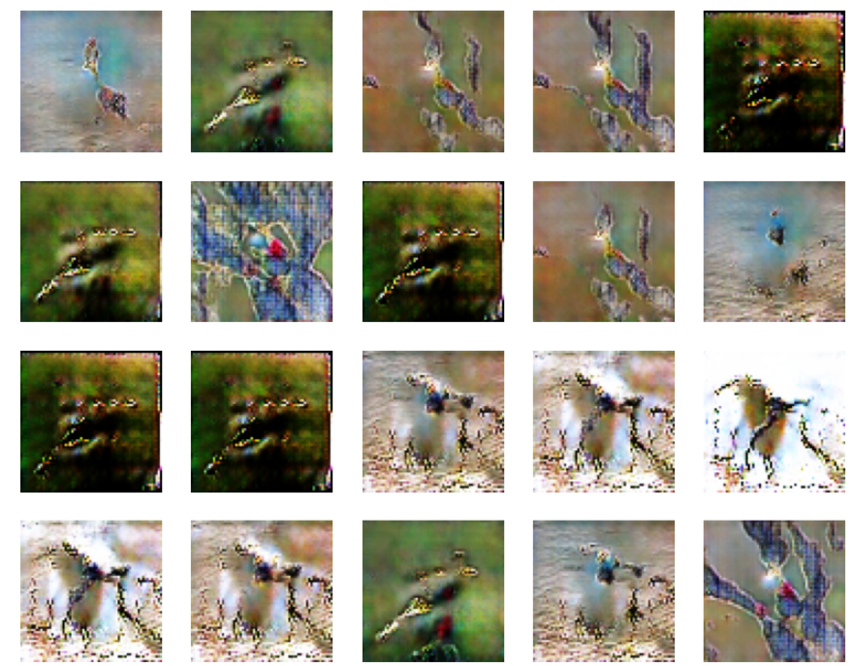
Second attempt: Instance Selection
Output for “This bird has red head and blue body.”
It shows the model repeating itself.
The image does not correspond to the text however it has red and blue colors.
It trained for 671 epochs
It needs further investigation.

Slide 14
Third Attempt use bigger model with instance selection
Instance selection allows downsizing, and subsequently, allows upsizing
In this attempt, we will try to add more batch normalization layers to the model before each leaky ReLU layer

Slide 15
Third Attempt use bigger model with instance selection
Quantitively, it scored an FID of 537
Which in comparison, to its simpler counterpart it performed worse

Slide 16
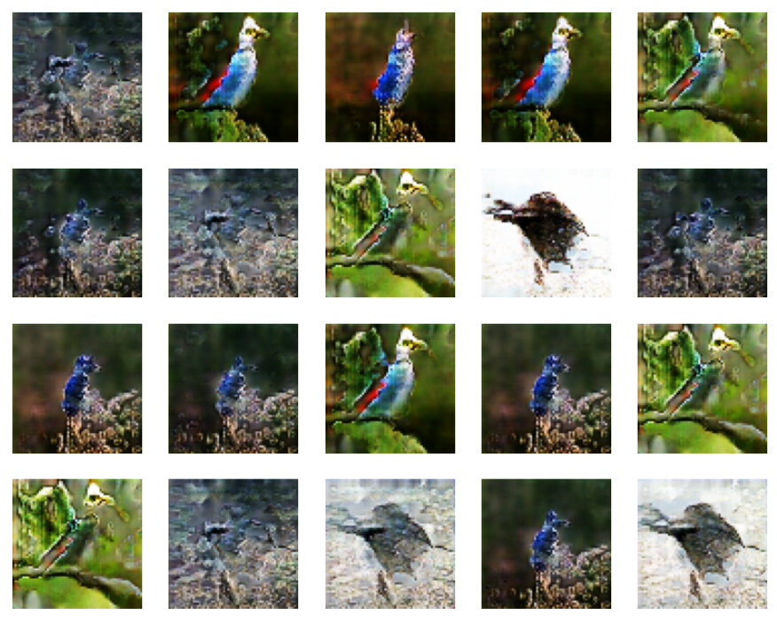
Third Attempt use bigger model with instance selection
Output for “This bird has red head and blue body”
Qualitatively, it looks better
It has a better alignment with the text
It is structurally better
It lacks diversity.
It trained for 731 epochs

Slide 17
Fourth Attempt: “Create embedding from scratch”
This attempt has two subsections
CBOW embeddings
Skipgram embeddings

Slide 18
Fourth Attempt: “Create embedding from scratch”
We observed it to be failed attempt
The dataset is not big enough for the embedding
Quantitively the skip-gram scored FID of 1122 and CBOW has scored 1173

Slide 19
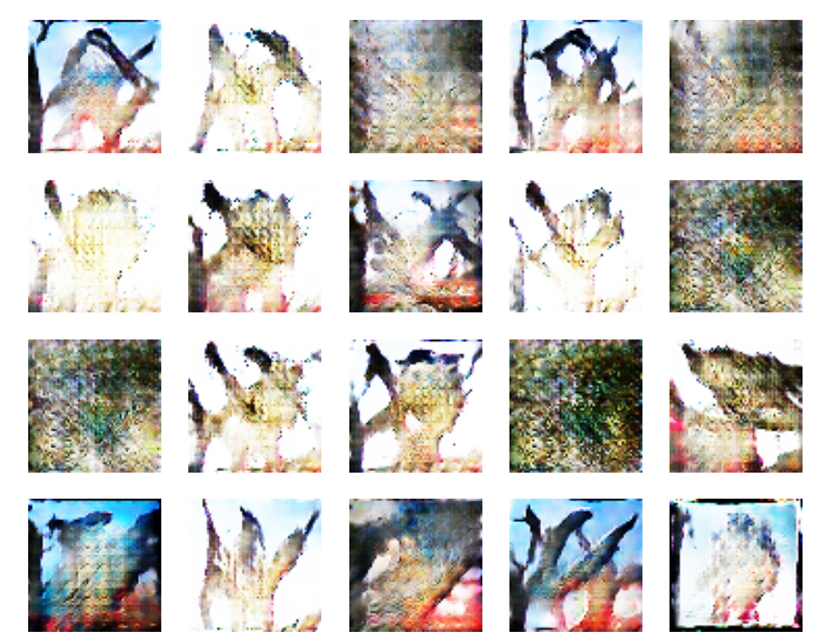
Fourth Attempt: “Create embedding from scratch”
Output for “This bird has red head and blue body”
Qualitative assessment for CBOW
It clearly looks nothing like the caption
It failed to structure birds
It was trained for 201

Slide 20
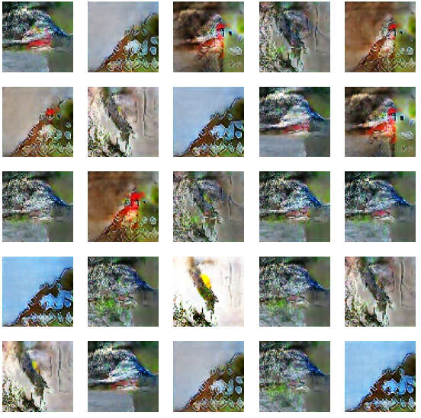
Fourth Attempt: “Create embedding from scratch”
Output for “This bird has red head and blue body”
Qualitative assessment for CBOW
It clearly looks nothing like the caption
It failed to structure birds
It was trained for 661 epochs.
It has some understanding of colors, but very low fidelity

Slide 21
Fifth Attempt: Use BERT
The input of the image has a clear impact on the generated image
On this attempt the BERT pooled output was used as an input vector.

Slide 22
Fifth Attempt: Use BERT
The difference is that dimension of the pooled output is 768
In the previous trials the input dimension was 300
Quantitively, it was the best attempt so far scoring 294

Slide 23
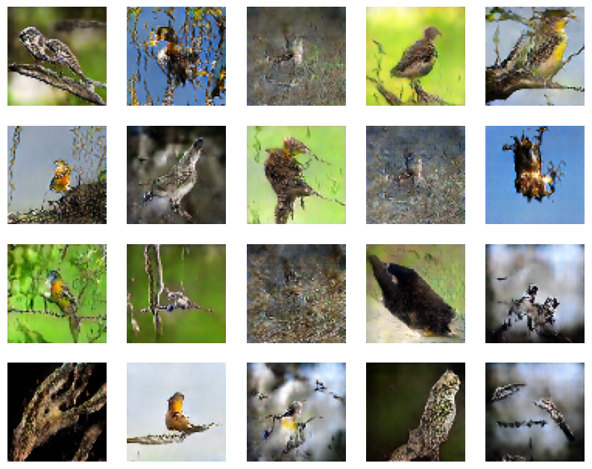
Fifth Attempt: Use BERT
Output for “This bird has red head and blue body.”
It has a better “bird structure” but no text alignment since the birds are not red nor blue
It possibly can be used with AttnGAN

Slide 24
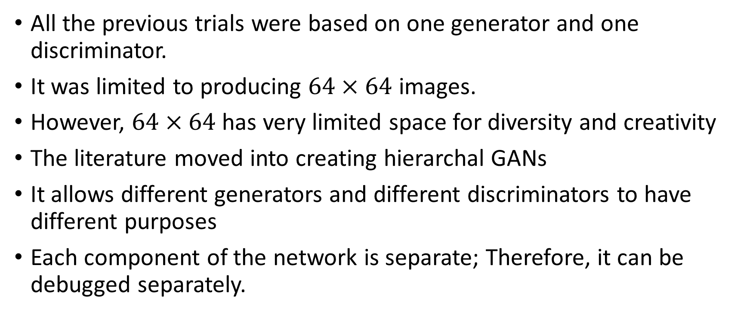
Hierarchal structures
All the previous trials were based on one generator and one discriminator.
It was limited to producing $64×64$ images.
However, $64×64$ has very limited space for diversity and creativity
The literature moved into creating hierarchal GANs
It allows different generators and different discriminators to have different purposes
Each component of the network is separate; Therefore, it can be debugged separately.

Slide 25
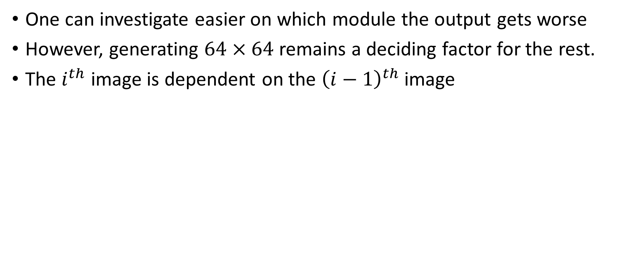
Hierarchal structures
One can investigate easier on which module the output gets worse
However, generating $64×64$ remains a deciding factor for the rest.
The $i^{th}$ image is dependent on the ${\left(i−1\right)}^{th}$ image

Slide 26
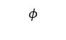
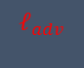
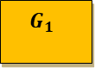

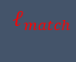
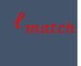
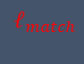
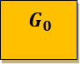

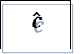
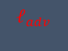
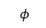
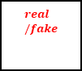
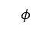
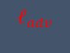
Hierarchal structures
Image
$$real/fake$$
$$𝓁_{match}$$
Z
$G_{0}$
D
Noise
$$φ$$
Discriminator
Generator
Embeddings
$$𝓁_{adv}$$
In text-to-image research, the earliest form of it was stack GAN
The stackGan iteratively generates the image through three generators
It improved the results qualitatively and quantitatively.
Conditioning augmentation is used to sample random conditioning variables from mean and the covariance matrix of the embeddings
Image
$$real/fake$$
$G_{1}$
D
$$𝓁_{match}$$
$$φ$$
Discriminator
$\hat{c}$
Generator
Embeddings
$$𝓁_{adv}$$
Conditioning augmentation extracted from text features
Image
$$real/fake$$
$$𝓁_{match}$$
D
$G_{2}$
$$φ$$
Generator
Embeddings
$$𝓁_{adv}$$

Slide 27
Attention is all you need
Based on the stacking generator idea, AttnGAN was introduced
The attnGAN learns the relationship between text and image in semi-supervised through the Dual Attention Multimodal Similarity Model (DAMSM) model.
The DAMSM model is semi-supervised as it is granted that the captions match the images, but it must know which word relates to which region in unsupervised way.

Slide 28
Attention is all you need
DAMSM model is composed of two encoder models
Text-Encoder: extracts semantic vectors from text description
Image-Encoder: maps image to semantic vectors.
Intermediate layers learns local features
Later layers learn global features
Image-Encoder is using pretrained InceptionNetworkV3 that is trained on ImageNet dataset.

Slide 29
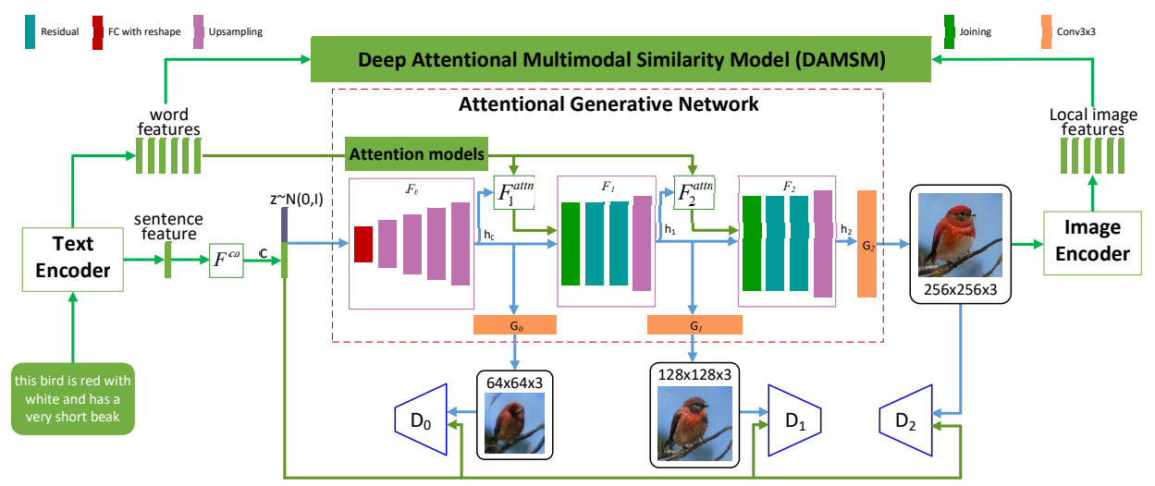
Attention is all you need
The first image is generated without attention
The attention model has two inputs, the image, and the text
The final image with the features inserted for DAMSM to calculate fine-grained image-text matching loss

Slide 30
Attention is all you need
Qualitatively and Quantitatively, AttnGAN gave the best results
It has the best text-image matching as described

Slide 31
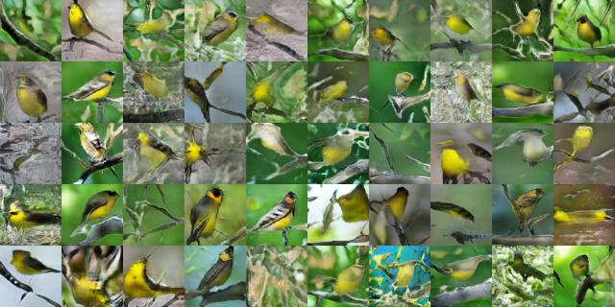
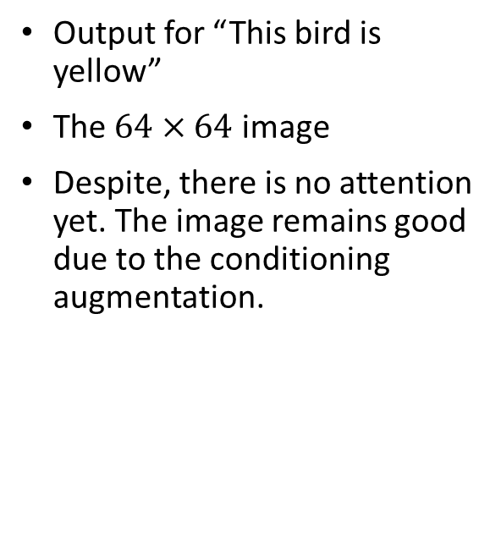
Attention is all you need
Output for “This bird is yellow”
The $64×64$ image
Despite, there is no attention yet. The image remains good due to the conditioning augmentation.

Slide 32
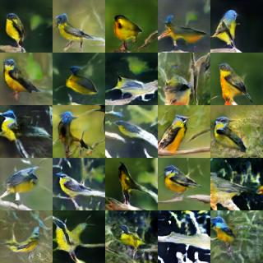
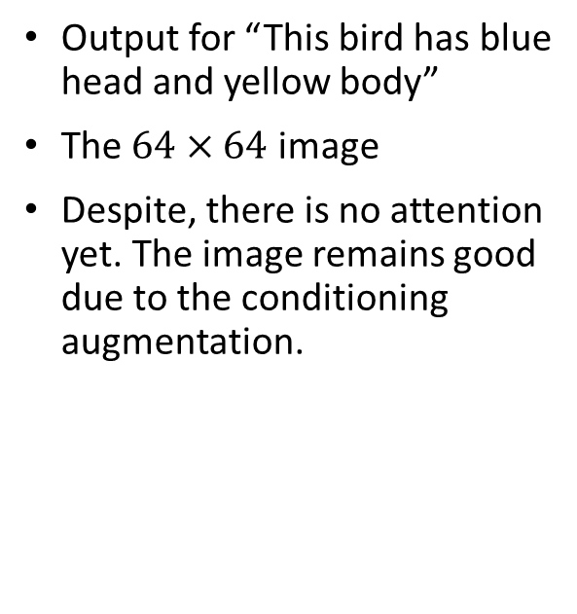
Attention is all you need
Output for “This bird has blue head and yellow body”
The $64×64$ image
Despite, there is no attention yet. The image remains good due to the conditioning augmentation.

Slide 33
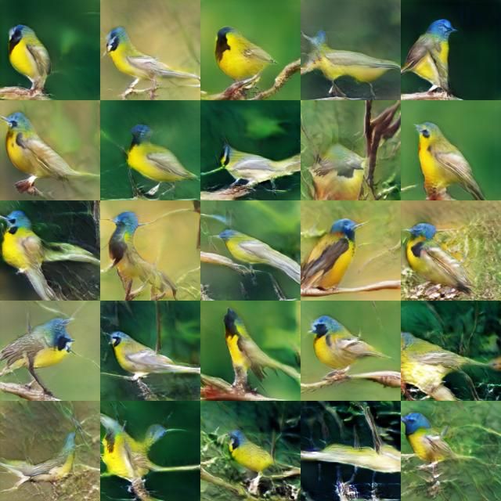
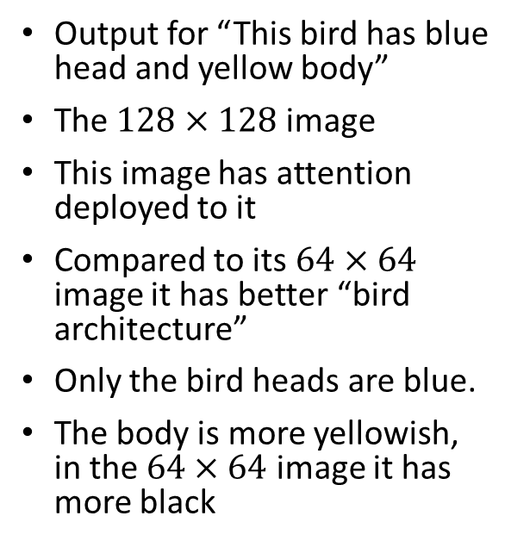
Attention is all you need
Output for “This bird has blue head and yellow body”
The $128×128$ image
This image has attention deployed to it
Compared to its $64×64$ image it has better “bird architecture”
Only the bird heads are blue.
The body is more yellowish, in the $64×64$ image it has more black

Slide 34
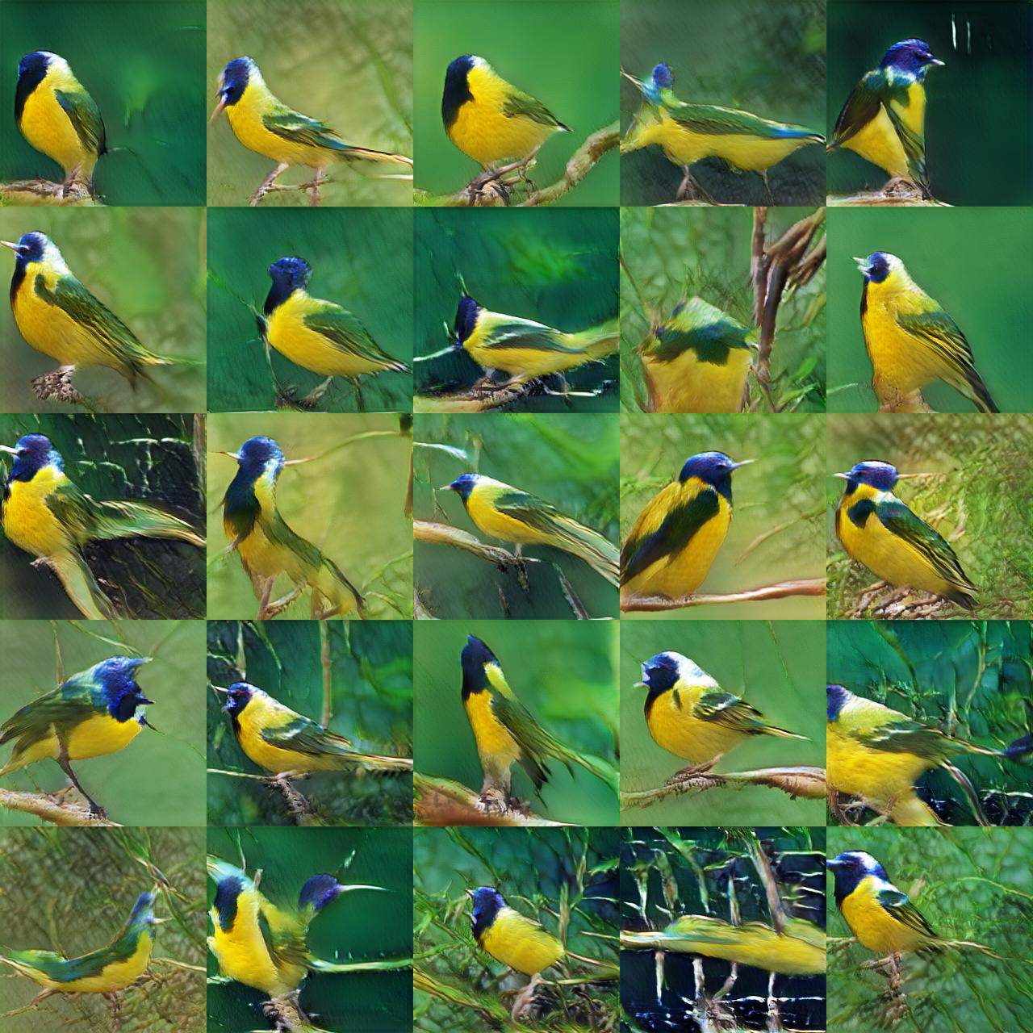
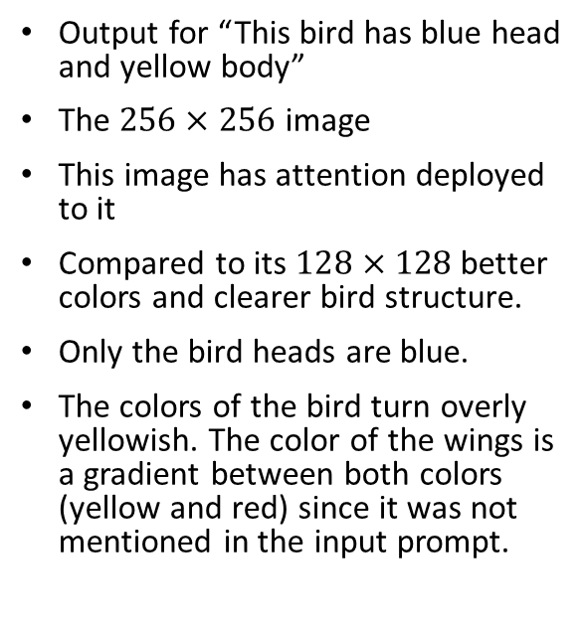
Attention is all you need
Output for “This bird has blue head and yellow body”
The $256×256$ image
This image has attention deployed to it
Compared to its $128×128$ better colors and clearer bird structure.
Only the bird heads are blue.
The colors of the bird turn overly yellowish. The color of the wings is a gradient between both colors (yellow and red) since it was not mentioned in the input prompt.

Slide 35
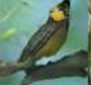
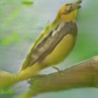
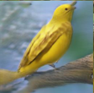
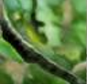
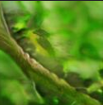
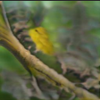
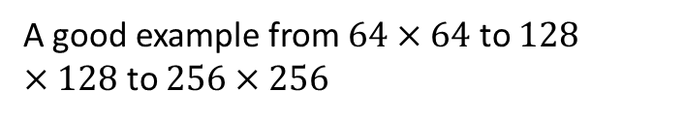
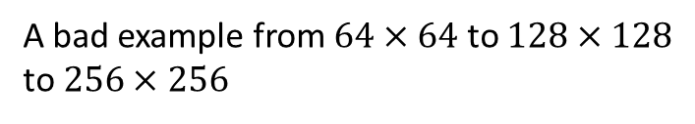
Attention is all you need
Evolution of good examples
Evolution of bad examples
A good example from $64×64$ to $128×128$ to $256×256$
A bad example from $64×64$ to $128×128$ to $256×256$

Slide 36
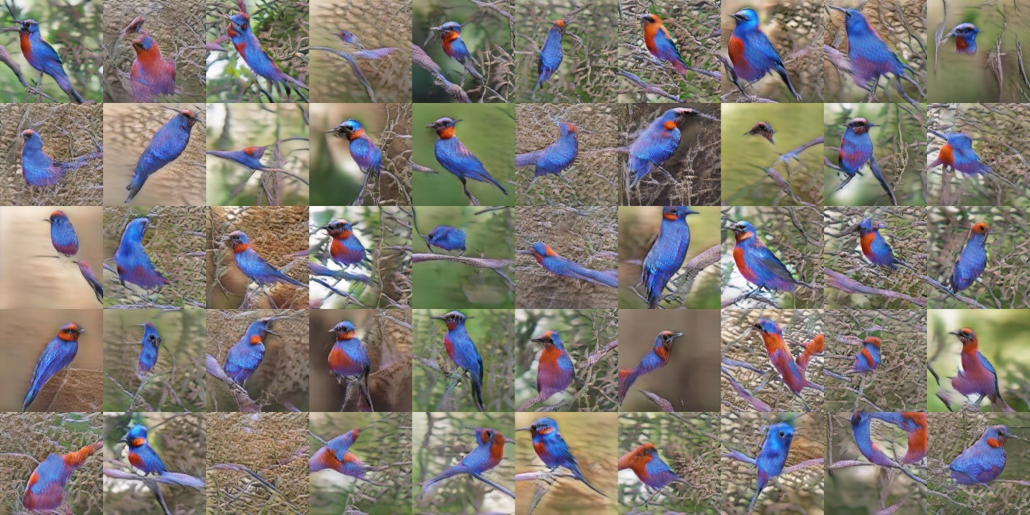
Where we started where we reached.
Prompt: “This bird has red head and blue body.”

Slide 37
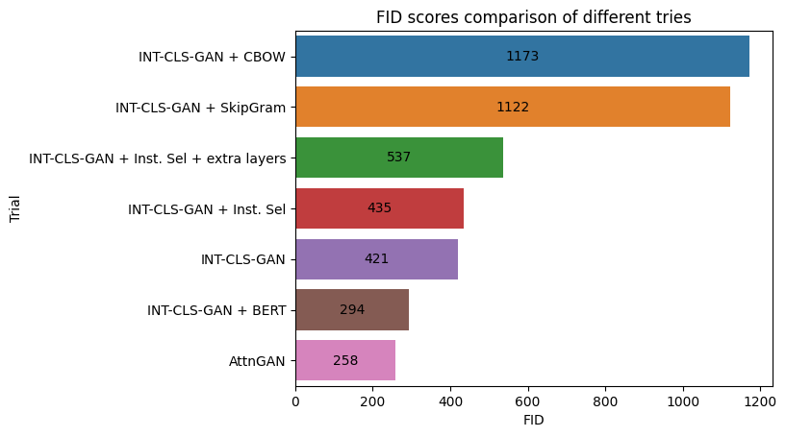
Quantitative Results of our different trials
This image summarizes the trials quantitively.
It shows our AttnGAN scores the best FID score
Instance selection reached closer Instance selection got a close score to INT-CLS-GAN with almost half of the epochs

Slide 38
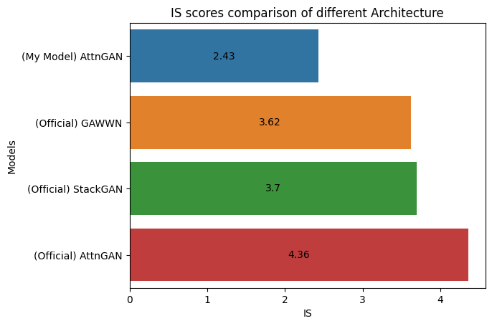
Quantitative Results of our best trial versus state-of-art.
We have a lower Inception score versus state-of-art as our model is trained only for 100 epochs with smaller batch size and minor parameter changes to fit into the available hardware
The official AttnGAN was trained for 550 epochs.
The official StackGAN was trained for 600 epochs
The official GAWWN training is unknown.

Slide 39
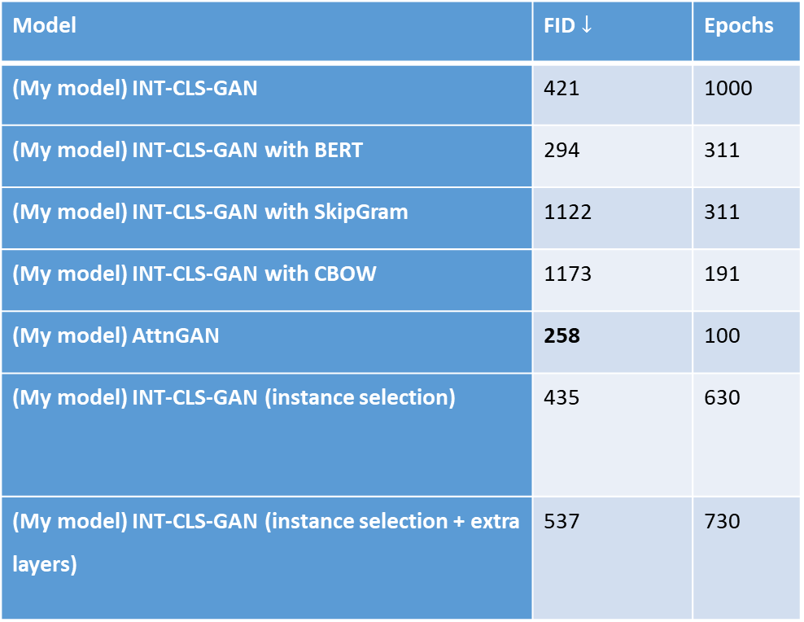
Closer look on our different trails
Model | FID $↓$ | Epochs
(My model) INT-CLS-GAN | 421 | 1000
(My model) INT-CLS-GAN with BERT | 294 | 311
(My model) INT-CLS-GAN with SkipGram | 1122 | 311
(My model) INT-CLS-GAN with CBOW | 1173 | 191
(My model) AttnGAN | 258 | 100
(My model) INT-CLS-GAN (instance selection) | 435 | 630
(My model) INT-CLS-GAN (instance selection + extra layers) | 537 | 730
We showed for each the results qualitatively and quantitively.
In this table, we show the number of epochs.

Slide 40
What is Inception Score and Fréchet Inception distance?
The inception score is built on InceptionV3 that is trained on ImageNet
It checks for probability for each class distribution such as 0.8 birds and 0.1 cats and so on.
It has the lowest score of 1.0 and the best score of 1000 as ImageNet has 1000 classes.
However, it can be gambled, and it does not take into consideration the real images. (if it generated one image for each class it can get a perfect score)
It does not care for text relevance.

Slide 41
What is Inception Score and Fréchet Inception distance?
Fréchet Inception distance is newer than the Inception Distance
It compares the coding layer, the last pooling layer prior to the classification output. It is used to capture specific computer vision features
Both real and fake images are summarized as multivariate Gaussian distribution
The distance between distribution is calculated using Fréchet distance
It is also known as (Wasserstein-2 distance).

Slide 42
Implementation Notes
TensorFlow and Pytorch were used, and the code is integrated through serialization.
The work environment was dockerized and built upon TensorFlow:latest-gpu-jupyter image.
The training speed was improved by storing repeatedly used information such as embeddings for the known dataset captions
The training in AttnGAN was improved by 53% by using numpy arrays instead of lists and got better GPU utilization
The implementation should be carefully written as much as the research.

Slide 43
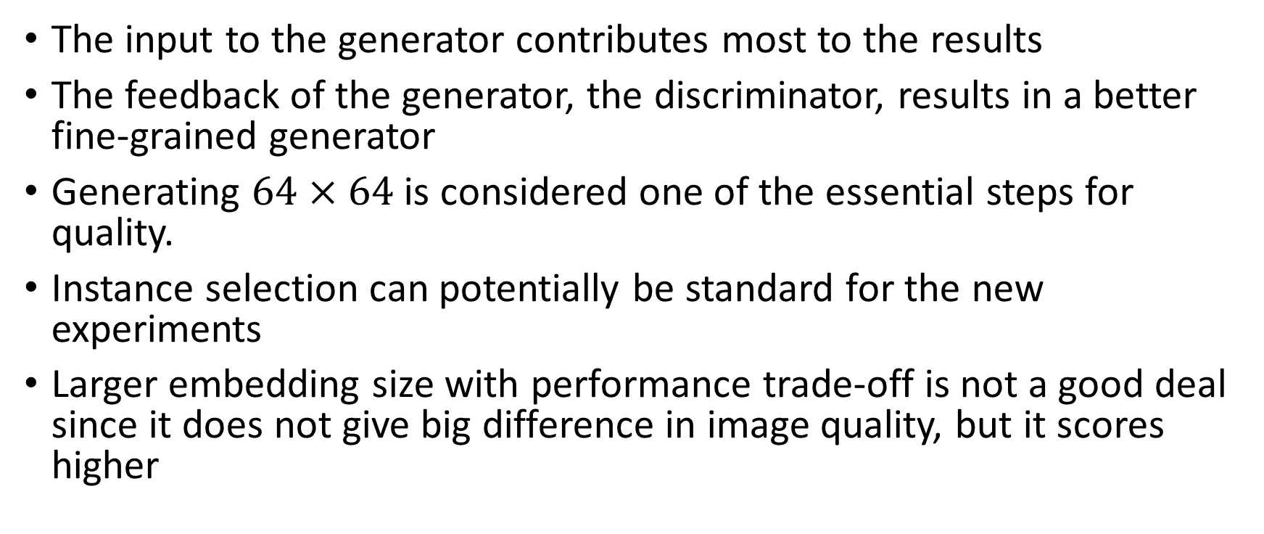
Project contribution and conclusions
The input to the generator contributes most to the results
The feedback of the generator, the discriminator, results in a better fine-grained generator
Generating $64×64$ is considered one of the essential steps for quality.
Instance selection can potentially be standard for the new experiments
Larger embedding size with performance trade-off is not a good deal since it does not give big difference in image quality, but it scores higher

Slide 44
Project contribution and conclusions
The noise should be statistically dependent on the generated dataset
Hierarchal architectures are better than using one deep network

Slide 45

Any Questions? Thank You!

